Slide 1
Notes:
Hello and welcome! Thanks for taking time out of your day to join us to learn about the 2025 Critical Language Scholarship Spark virtual initiative! We are excited that you are considering applying to CLS Spark for next summer!
CLS Spark a virtual initiative of the CLS Program and a program of the U.S. Department of State, with funding provided by the U.S. Government, and supported in its implementation by our team at American Councils for International Education.

Slide 2
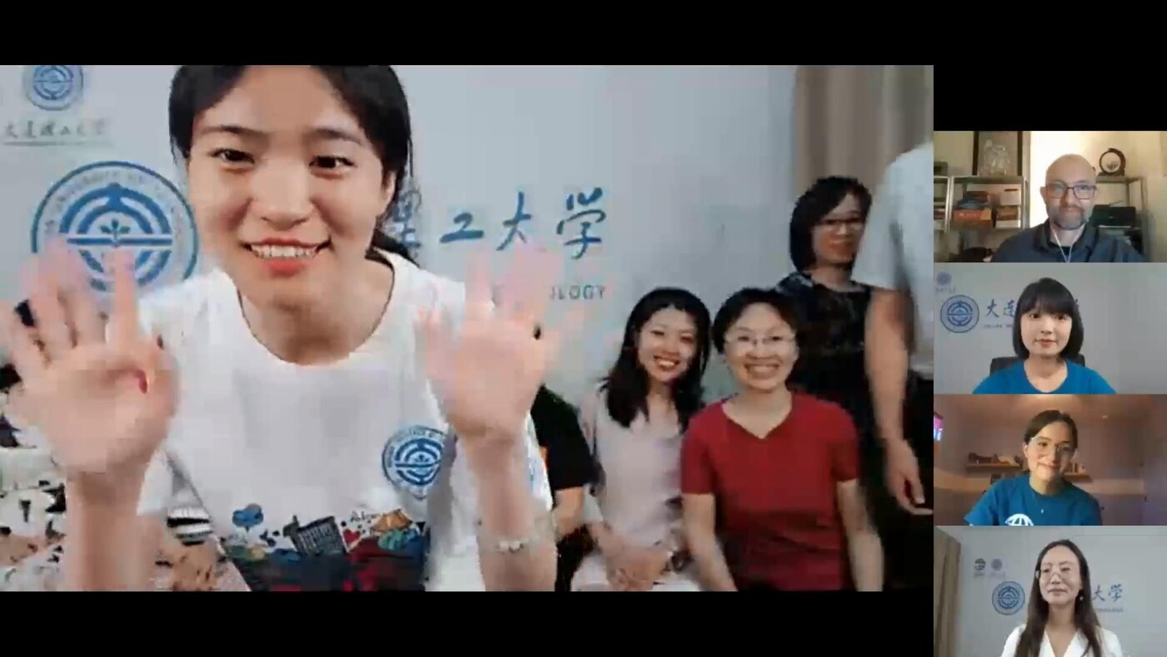
CLS Spark
CLS Spark Overview
Program benefits
Application tips
Questions!
Notes:
We will begin this presentation with an overview of CLS Spark – what the scholarship provides and what the initiative is all about. Then we’ll talk about some of the benefits of participating in CLS Spark, and give you all some tips for preparing a competitive application.
At the end, we will answer any questions that you have about CLS and the application process. We’ll be answering questions entered in the Q&A box here in Zoom, so you’re welcome to add questions there any time, and then we’ll answer those that aren’t addressed in the presentation once we’re through with our slides.

Slide 3

What is CLS Spark?
Immersive summer opportunity to study languages and cultures essential to America’s engagement with the world
Funded by the U.S. Government
Apply for a language program either offered virtually through CLS Spark or overseas
For undergraduate students only
Notes:
CLS Spark is an intensive summer opportunity, funded by the U.S. government, for students to study one of five languages essential to our engagement with the world.
CLS Spark supports U.S. students in all fields of study to learn what the U.S. Department of State refers to as “critical” languages.
Critical languages are languages that are essential to the United States’ national security, economic prosperity, and engagement with the world, and they tend to be less commonly taught in the United States. Studying these languages also helps prepare scholars to compete in a globalized workforce.
CLS scholars participate in virtual courses and activities offered through partner institutes abroad, developing regional and cultural knowledge and forming connections with local students and instructors.
Students may apply for CLS Spark, which is a virtual initiative for beginning- and advanced beginning-level instruction, or for the CLS Program, through which they will study at a CLS host institute overseas.
In today’s session, we will focus on the CLS Spark virtual initiative. The full list of webinars we are offering this fall can be found on our website at c-l-scholarship [dot] org [forward slash] events.

Slide 4
Languages Offered
CLS Spark Virtual Institutes
Experience Level | Languages
Open to beginners with no formal classroom experience | Arabic, Chinese, Korean, and Russian
Open to beginners with no formal classroom experience and students with one year of prior study | Japanese
Notes:
CLS Spark offers virtual instruction for beginning-level Arabic, Chinese, Korean, and Russian, as well as beginning- and advanced beginning-level Japanese. Each course will be designed for students with little to no previous experience studying these languages. Students applying for Japanese at the advanced beginning level need one year of prior study. You may substitute other language learning experience for this pre-requisite, such as self-study, tutoring, high-school coursework, or knowledge of the language from your home environment.
If you are at intermediate, or advanced level, we encourage you to check out the CLS Program overseas institutes instead.

Slide 5

Structure
Students participate as a cohort and share the same weekly schedule
  Small classes
  Individual consultations
  Peer language partner
  Cultural programming
CLS Spark is intensive, highly structured virtual international exchange
Notes:
CLS Spark takes place over the course of 8—9 weeks during the summer and is facilitated by host institutes abroad. Students participate in the program as a member of a cohort, sharing the same schedule over the course of the program.
Each cohort of students participates in a total of 90 hours of programming. Each week, this includes 10 hours of live, synchronous class instruction. In addition, participants spend time learning about the culture of partner institutions in interactive and engaging cultural activities, such as tea ceremonies, calligraphy lessons, films, and virtual city tours. Each week, CLS Spark participants have individualized tutoring sessions with their instructors, adapted to their specific needs.
Beginning the fifth week of the program, CLS Spark participants meet with language partners from host communities to help practice their everyday conversation skills.
Participants of CLS Spark also build community with each other through optional career development workshops and networking opportunities. These workshops will include advice from CLS alumni on applying to the CLS Program overseas institutes, and sessions to inform and prepare students for more scholarship and career opportunities.
As you can see, CLS Spark is more than just an online program—it's an intensive, highly structured virtual international exchange. Participants should anticipate dedicating around 20 hours per week to class time, language partner meetings, consultations with institute staff, and homework. Given the demanding schedule, they may not have the flexibility for independent travel, full-time research, or internships.

Slide 6
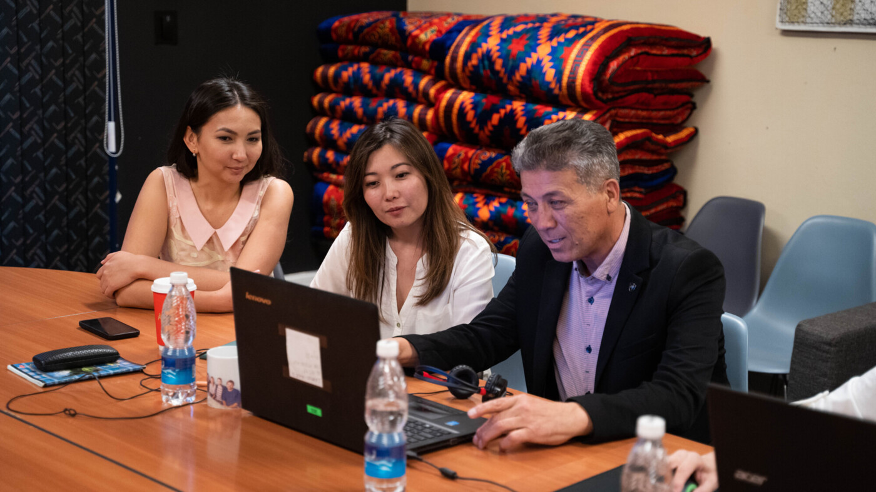
Program Benefits
Virtual instruction
Course materials
Cultural programming
Supplemental technology stipend
Notes:
For some, the most exciting thing about CLS Spark is that it is funded by the U.S. government.
Costs covered include language instruction and cultural programming, as well as all course materials. The scholarship also provides a modest stipend to use toward supplementary technology and equipment and connectivity costs that will help participants succeed in an all-virtual program.

Slide 7
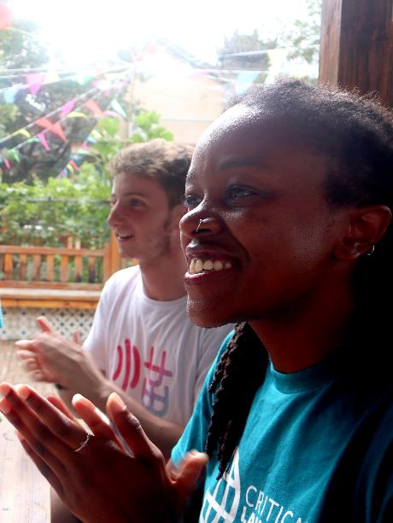
Program Benefits
Make substantial gains in language skills:
  Two semesters’ worth of coursework (and academic credit through Bryn Mawr College)
  Certified OPI certificate to demonstrate language proficiency
  CLS Spark participants are automatic semi-finalists for the 2026 CLS Program overseas institutes
Notes:
For some, the most exciting thing about CLS Spark is that it is funded by the U.S. government.
Costs covered include language instruction and cultural programming, as well as all course materials. The scholarship also provides a modest stipend to use toward supplementary technology and equipment and connectivity costs that will help participants succeed in an all-virtual program.
CLS Spark participants make significant gains in their language abilities.
In just eight to ten weeks, students complete the equivalent of two semesters of undergraduate coursework or a year’s worth of language learning. Students receive certification of their language gains through an ACTFL-OPI certificate upon completion of their program and undergraduate credit through Bryn Mawr College, which is documented on an official transcript.
Last but not least, students in CLS Spark are encouraged to apply for the CLS Program overseas institutes to continue their language learning journeys by studying their target language abroad. Those who apply for the CLS Program overseas institutes following their completion of CLS Spark will automatically be considered semifinalists for that opportunity.

Slide 8
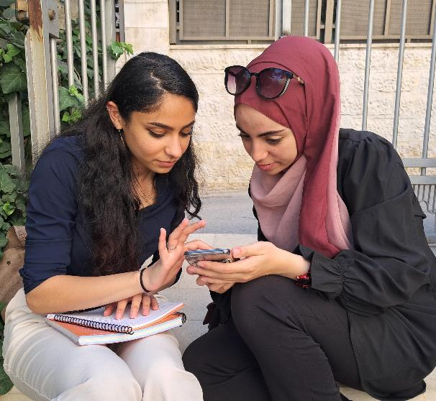
Advance Your Career!
Advance your career:
  U.S. companies give advantage to candidates with language skills
  Build experience in problem solving, adaptability, and other employable skills
  CLS Program and Department of State International Exchange alumni networks and resources
  Non-competitive eligibility (NCE) for federal government positions
Notes:
Proficiency in a critical language, as well as cross-cultural competency, can open doors for alumni seeking further academic and employment opportunities.
Alumni frequently speak of the benefit of joining a vibrant and engaged community of international exchange alumni. Fellow CLS Spark alumni often become a source of support when navigating career decisions or additional fellowships and scholarships post-CLS. CLS Spark alumni also become a part of the rich and diverse network of U.S. Department of State International Exchange Alumni.
And while CLS Spark participants have no service commitment to the U.S. government after completion of the program, alumni are eligible for non-competitive eligibility for U.S. government jobs, which makes pursuing a career in the civil service much easier if that is your goal.

Slide 9
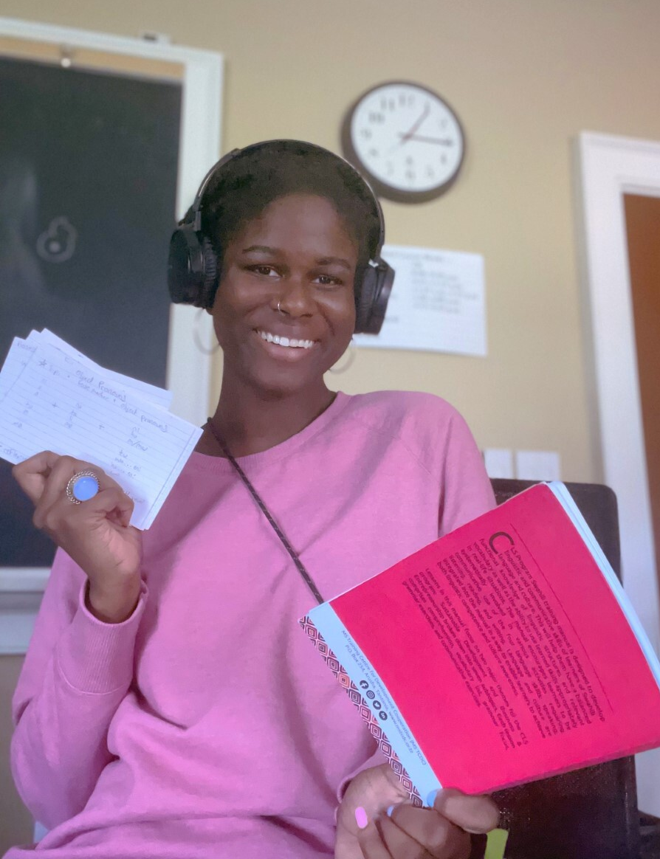
Eligibility
U.S. citizen or national
Enrolled in a degree-seeking program at a U.S. based institution
Must be earning an undergraduate (associate, bachelor's) degree
Graduating seniors are eligible
No GPA requirement
Notes:
Students are eligible for CLS Spark if they are U.S. citizens or nationals enrolled in an accredited degree-granting program at a U.S.-based institution at the time of applying. Participants must be 18 years old by May 15, 2025, and have completed at least one full year of college-level study by the start of the program.
Applicants for the CLS Spark must be at the undergraduate level. Students who are graduating seniors at the time of application are eligible to apply.
Students from any field of study can prepare a competitive application for CLS Spark. We want applications from students of all majors at all levels of language learning, and we encourage students of all disciplines to think about how critical languages can help their careers.
A full list of eligibility criteria for applicants can be found on our website at c-l-scholarship [dot] org [forward slash] applicants [forward slash] eligibility.

Slide 10
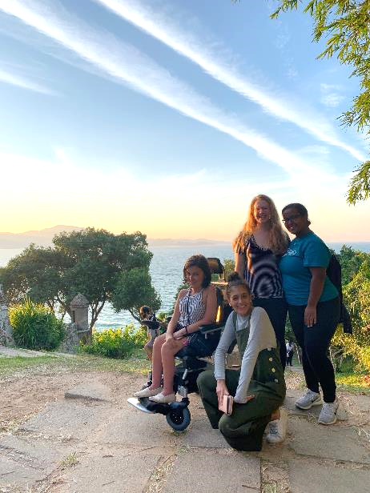
An Opportunity for Everyone
CLS represents the breadth of the U.S.:
  All fields of study
  All types of institutions and regions of the U.S.
  Different levels of experience with language and travel
  Over 50% self-identify as students of color
  Over 30% receive Pell Grants
The CLS Program does not discriminate on the basis of disability or medical condition
Inclusive student support structures
Notes:
Our cohorts represent the breadth of the United States, with students coming from all different academic backgrounds, fields, degree programs – and different levels of experience with language and travel.
We actively recruit students from all 50 states and from groups underrepresented in study abroad, including students of color, students with disabilities, students from community colleges, and non-traditional students.
CLS Spark is a great opportunity for all students, and we work year-round with the Department of State and our partner institutions to ensure that inclusive support structures are in place to ensure a successful summer for all scholars.

Slide 11

CLS Spark—Essays & Criteria
Three Short Answer Essays (300-350 words)
  Motivation and Commitment
  Access to Language Learning Opportunities
  Statement of Experience
No letter of recommendation required
Applicants should focus on the impact of CLS Spark on their access to language and intercultural learning opportunities
Preference is given to applicants from campuses that do not offer the target language
Notes:
The application for the 2025 CLS Spark virtual initiative includes three short-answer essays. There is no letter of recommendation requirement.
The first essay is a statement of motivation and commitment. In this essay, an applicant should address their interest in their target language, and how their interest relates to personal, academic and professional goals.
The second essay is the statement of access to language learning opportunities. Here, students are asked to reflect on what barriers they have encountered in their pursuit of language study and why CLS Spark is a necessary and unique opportunity.
Finally, students are to reflect in the statement of experience what unique experiences, perspective, and/or background they can contribute to their cohort and how they can contribute to the larger goal of mutual understanding.
A full list of selection criteria for applicants can be found on our website at c-l-scholarship [dot] org [forward slash] applicants [forward slash] selection.

Slide 12
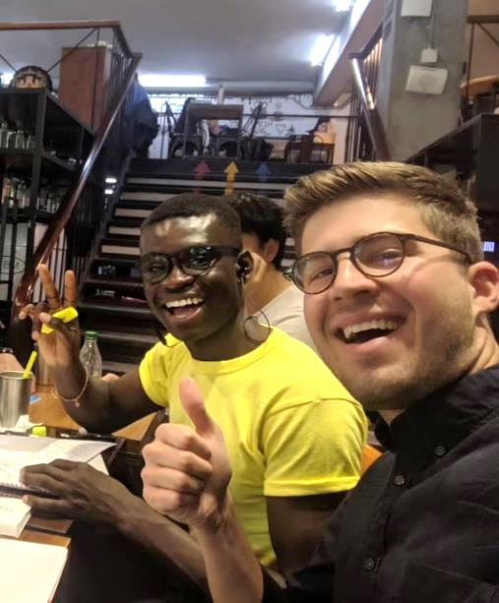
Resources!
Do your homework
  Articulate how the access and opportunity offered by CLS Spark connects to your academic and professional goals
  Watch the application tips video!
Seek help on your campus!
  Instructors and advisors
  Writing centers
  Study abroad, fellowships,
  and scholarships offices
Notes:
We recommend checking out our short videos on the application timeline and selection process, as well as our application tips video which talks you through how to craft strong responses to each of the essay prompts.
We strongly recommend reaching out to professors and trusted resources on your campus for help with your application. Faculty and instructors might have ideas for areas of international interest in your field. A writing center, fellowship or scholarship office, study abroad office, or honors program may be good places to start to get feedback on your essays.

Slide 13

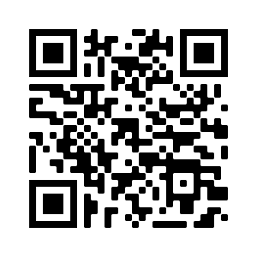
Apply for Summer 2025
Application Deadline: November 19, 8:00 pm EST
Semifinalist Notification: Late January
Finalist Notification: March
Programs Begin: June
Online application at
www.clscholarship.org/apply
Notes:
The application for CLS Spark will open in early October/is already open and will close on November 19 at 8 PM ET or 5 PM PT. We recommend submitting well in advance of the deadline to avoid any last-minute computer glitches that might prevent you from submitting on time!
By late January, every applicant will be notified by email of whether they will advance to the second round of selection.
Those who advance to the second round can expect to be notified by early March of whether they have been selected for the award. Students who are selected for the award will have about two weeks to either accept or decline the offer, at which point declined awards will be offered to alternate candidates.

Slide 14




Stay in Touch
Follow us for updates!
Join us for future webinars.
Register at clscholarship.org/events
@CLScholarship
@CLSScholarship
fb.com/CLScholarship
Notes:
CLS will be offering alumni panels at the end of September, webinars on virtual study through CLS Spark at the beginning of October, and weekly office hours until mid-November. You can register for these virtual events and more at c-l-scholarship [dot] org [forward slash] events.
We also strongly encourage you to follow CLS on social media! There you can find alumni stories, tips on crafting a compelling application and stay up to date on program announcements.

Slide 15


Questions?
cls@americancouncils.org
CLScholarship.org/events
@CLScholarship
fb.com/CLScholarship
@CLSScholarship
Notes:
Thank you again for taking the time to join us this afternoon. We’ll go through questions in the order they’ve come in through the Q&A window.

