Slide 1
Notes:
Hello and welcome! Thanks for joining us to learn about the 2025 Critical Language Scholarship Program and application. We are excited that you are considering applying to the CLS Program for next summer!
The CLS Program is a program of the U.S. Department of State, with funding provided by the U.S. Government, and supported.

Slide 2
Welcome!
CLS Program overview
Program benefits
Application tips
Q&A
Notes:
We will cover in this presentation an overview of the CLS Program, the program structure for the overseas institutes, the benefits of participating, and tips for writing a compelling application. Feel free to use the Q&A box feature as we go along, and we’ll have time at the end of the presentation to answer any of your questions.

Slide 3
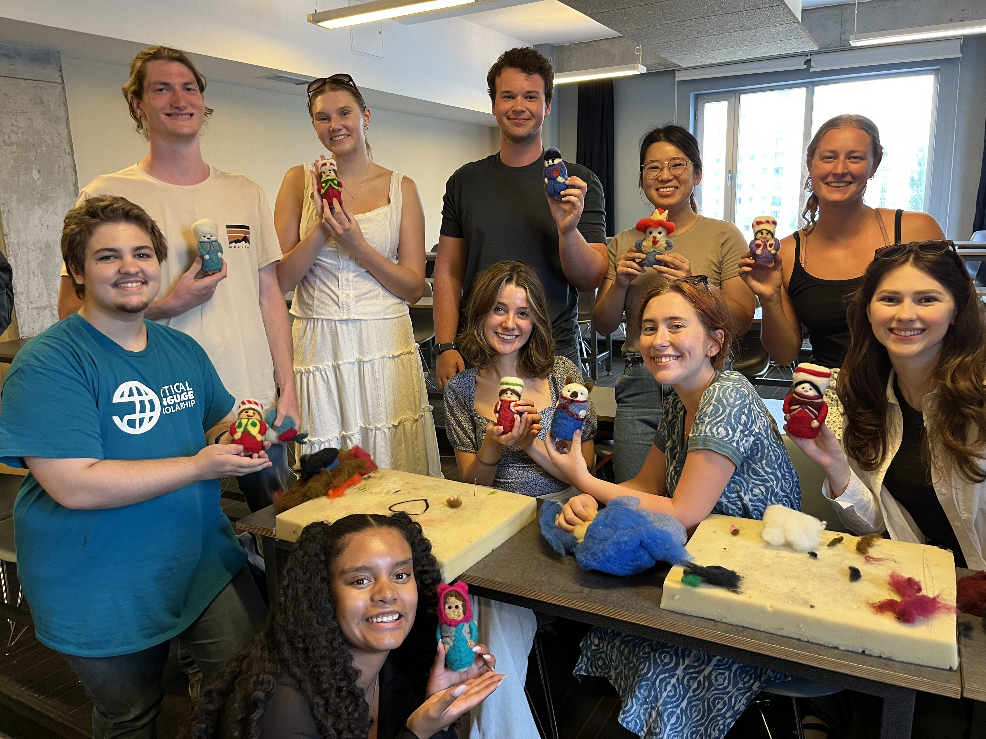
What is the CLS Program?
Immersive summer opportunity to study languages and cultures essential to America’s engagement with the world
Funded by the U.S. Government
Apply for a language program either overseas or offered virtually through CLS Spark
Notes:
The CLS Program is an intensive summer opportunity, funded by the U.S. government, for students to study one of a dozen languages essential to our engagement with the world.
The CLS Program supports U.S. students in all fields of study to learn what the U.S. Department of State refers to as “critical” languages.
Critical languages are languages that are essential to the United States’ national security, economic prosperity, and engagement with the world, and they tend to be less commonly taught in the United States. Studying these languages also helps prepare scholars to compete in a globalized workforce.
CLS scholars participate in courses and activities offered through partner institutes abroad, developing regional and cultural knowledge and forming connections with local students and instructors.
Students may apply for the CLS Program, through which they will study at a CLS host institute overseas, or for CLS Spark, which is a virtual initiative offering beginning-level Arabic, Chinese, Korean, and Russian, as well as beginning- and advanced beginning-level Japanese.
In today’s session, we will focus on the CLS Program overseas. The full list of webinars we are offering this fall can be found on our website at c-l-scholarship [dot] org [forward slash] events.

Slide 4
Languages Offered
The CLS Program Overseas Institutes
Experience Level | Languages
Open to students at all language levels, including beginners | Hindi, Indonesian, Persian, Portuguese, Swahili, Turkish and Urdu
One year of prior study required | Arabic, Chinese, Korean and Russian
Two years of prior study required | Japanese
Notes:
The CLS Program offers overseas instruction in a dozen critical languages.
Some CLS languages have prerequisite requirements to participate in the CLS Program overseas. Arabic, Chinese, Korean, and Russian require one year of prior experience and Japanese requires two years of previous language learning experience to participate in the CLS Program at institutes abroad.
Students applying for languages with pre-requisites may substitute other language learning experience for formal classes, such as self-study, tutoring, high-school coursework, or knowledge of the language from their home environment. There is space in the application for students to describe their experience and how it meets the proficiency requirement for the level to which they are applying. Students applying for languages with pre-requisites must plan to meet the requirement by the beginning of June, before the CLS Program begins.

Slide 5
Structure
Students participate as a cohort and share the same weekly schedule
Small classes
Individual consultations
Peer language partner
Cultural programming
CLS is not a research, independent study, or internship program
Notes:
The CLS Program takes place over the course of 8—10 weeks during the summer at overseas institutes. Students participate in the program as a member of a cohort, sharing the same schedule over the course of the program which includes 15 hours of language classes each week, cultural activities, local excursions, and one or two weekend overnight group trips.
The CLS Program is an intensive and highly structured study abroad program. Students may not have time in their schedules to participate in independent travel, and should not plan to engage with research or internship opportunities.
The program is academically challenging, and every aspect is designed to maximize language gains and scholars’ immersion in the host culture.
In addition to language courses, students participate in a range of immersive cultural activities. In the past, CLS Japanese students studied Calligraphy, Turkish scholars prepared Çiğ köfte (pronounced like “chee kofteh”), which is a traditional meatball dish, and Indonesian students played Gamelan, a metal percussion ensemble.
Participants agree to a language policy that requires them to speak only in the language they are studying.
Each participant is paired with a language partner who is a local student or member of the host community to practice speaking outside the classroom. CLS alumni report their language partners are often their favorite part of the program and become quick life-long friends.
The CLS Program puts a strong focus on students getting the opportunity to connect with the local culture in their host country/region and form friendships with local people. Whenever possible the CLS Program will place students with host families.

Slide 6
Program Benefits
Round-trip international airfare
Applicable visa fees
Housing and meals
Classroom instruction
Cultural programming and group trips
Notes:
For some, the most exciting thing about the CLS Program is that it is funded by the U.S. government.
Costs covered for the overseas program include round-trip international airfare to your program site in addition to any applicable visa fees, housing and meals, classroom instruction, and the cost of program-sponsored cultural programming and group trips in the host country.

Slide 7
Program Benefits
Make substantial gains in language skills:
Two semesters’ worth of coursework (and academic credit through Bryn Mawr College)
Certified OPI certificate to demonstrate language proficiency
Notes:
CLS Program participants make significant gains in their language abilities.
In just eight to ten weeks, students complete the equivalent of two semesters of undergraduate coursework or a year’s worth of language learning. The immersive nature of the program is the reason many alumni tell us their language fluency was at its peak after CLS. Students receive certification of their language gains through an ACTFL-OPI certificate upon completion of their program and undergraduate credit through Bryn Mawr College, which is documented on an official transcript.

Slide 8
Advance Your Career!
Advance your career:
U.S. companies give advantage to candidates with language skills
Build experience in problem solving, adaptability, and other employable skills
CLS Program and Department of State International Exchange alumni networks and resources
Non-competitive eligibility (NCE) for federal government positions
Notes:
Proficiency in a critical language, as well as cross-cultural competency, can open doors for alumni seeking further academic and employment opportunities. Studying abroad will help you develop and hone skills that employers seek, such as resilience, adaptability, confidence, and a growth-mindset.
Alumni frequently speak of the benefit of joining a vibrant and engaged community of international exchange alumni. Fellow CLS Program alumni often become a source of support when navigating career decisions or additional fellowships and scholarships post-CLS. CLS alumni also become a part of the rich and diverse network of U.S. Department of State International Exchange Alumni.
And while CLS participants have no service commitment to the U.S. government after completion of the program, alumni are eligible for non-competitive eligibility for U.S. government jobs, which makes pursuing a career in the civil service much easier if that is your goal.

Slide 9
Eligibility
U.S. citizen or national
Enrolled in a degree-seeking program at a U.S. based institution
Must be earning an undergraduate (associate, bachelor's) or graduate (master's, doctoral, professional) degree
Graduating seniors are eligible
No GPA requirement
Notes:
Students are eligible for the CLS Program if they are U.S. citizens or nationals enrolled in an accredited degree-granting program at a U.S.-based institution at the time of applying. Participants must be 18 years old by May 15, 2025, and have completed at least one full year of college-level study by the start of the program.
Applicants for the CLS Program at overseas institutes may be at the undergraduate or graduate level. Students who are graduating seniors at the time of application and students enrolled in one-year master’s programs are eligible to apply.
Students from any field of study can prepare a competitive application for the CLS Program. We want applications from students of all majors at all levels of language learning, and we encourage students of all disciplines to think about how critical languages can help their careers.
A full list of eligibility criteria for applicants can be found on our website at c-l-scholarship [dot] org [forward slash] applicants [forward slash] eligibility.

Slide 10
An Opportunity for Everyone
CLS represents the breadth of the U.S.:
All fields of study
All types of institutions and regions
Different levels of experience with language and travel
Over 50% self-identify as students of color
Over 30% receive Pell Grants
The CLS Program does not discriminate on the basis of disability or medical condition
Inclusive student support structures
Notes:
Our cohorts represent the breadth of the United States, with students coming from all different academic backgrounds, fields, degree programs – and different levels of experience with language and travel.
We actively recruit students from all 50 states and from groups underrepresented in study abroad, including students of color, students with disabilities, students from community colleges, and non-traditional students.
The CLS Program is a great opportunity for all students, and we work year-round with the Department of State and our partner institutions to ensure that inclusive support structures are in place to ensure a safe and successful summer for all scholars.

Slide 11
CLS Program—Essays & Criteria
Three Short Answer Essays (300 words each)
Citizen Diplomacy and Mutual Understanding
Preparation for the CLS Program
Commitment to Language Study
Personal Statement (500 words)
No letter of recommendation required
Applicants should demonstrate a strong connection between participating in the CLS Program and their career and academic goals
Applicants must also show resiliency and preparation for an intensive and immersive language program
Notes:
The application for the 2025 CLS Program includes three short-answer essays and a personal statement. There is no letter of recommendation requirement.
The first essay addresses citizen diplomacy and mutual understanding. A key goal of the CLS Program is to increase and broaden the number of Americans who study and speak critical languages in order to develop mutual understanding between the people of the United States and people of other countries. With the goal of mutual understanding, CLS scholars are responsible for representing the United States as citizen diplomats in their host communities. In this essay, applicants should address how their experiences, perspectives, and/or background will contribute to their role as a citizen diplomat and the overarching mission of building mutual understanding. Additionally, applicants should explain how they plan to contribute to the mission of building mutual understanding and represent their host community upon returning to the United States.
The second short-answer essay addresses preparation for the program. Studying abroad requires resilience, openness, sensitivity, and adaptability. Applicants should discuss what challenges they anticipate while on the CLS Program and how they plan to succeed by drawing on examples of how they’ve overcome challenges in the past.
The third short-essay addresses commitment to language study. Here, applicants should explain what opportunities, if any, they have taken advantage of in pursuit of studying their target language; how CLS fits into their plan to develop proficiency in their target language; and how they will continue to study and engage with their language after the program.
Presenter 1: In the personal statement, applicants need to articulate their interest in the target language, their long-term academic and career goals, how the CLS Program is central in achieving those goals, and what qualities, perspectives, and/or experiences make them a good candidate for the program.
A full list of selection criteria for applicants can be found on our website at c-l-scholarship [dot] org [forward slash] applicants [forward slash] selection.

Slide 12
Resources!
Do your homework
Do research to connect the career path you are on to one of these languages/cultures
Watch the application tips video!
Seek help on your campus!
Instructors and advisors
Writing centers
Study abroad, fellowships, and scholarships offices
Notes:
We recommend checking out our short videos on the application timeline and selection process, as well as our application tips video which talks you through how to craft strong responses to each of the essay prompts.
We strongly recommend reaching out to professors and trusted resources on your campus for help with your application. Faculty and instructors might have ideas for areas of international interest in your field. A writing center, fellowship or scholarship office, study abroad office, or honors program may be good places to start to get feedback on your essays.

Slide 13
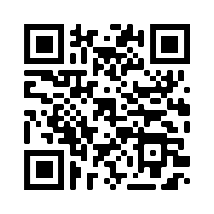
Apply for Summer 2025
Application Deadline: November 19, 8:00pm EST
Semifinalist Notification: Late January
Finalist Notification: March
Programs Begin: June
Online application at
www.clscholarship.org/apply
Notes:
The application for the 2025 CLS Program will open in early October/is already open and will close on November 19 at 8 PM ET or 5 PM PT. We recommend submitting well in advance of the deadline to avoid any last-minute computer glitches that might prevent you from submitting on time!
By late January, every applicant will be notified by email of whether they will advance to the second round of selection.
Those who advance to the second round can expect to be notified by early March of whether they have been selected for the award. Students who are selected for the award will have about two weeks to either accept or decline the offer, at which point declined awards will be offered to alternate candidates.

Slide 14
Stay in Touch
Follow us for updates!
Join us for future webinars.
Register at clscholarship.org/events
@CLScholarship
@CLSScholarship
fb.com/CLScholarship
Notes:
The CLS Program will be offering alumni panels at the end of September and webinars on CLS Spark and this year’s languages throughout October and weekly office hours until mid-November. You can register for these virtual events and more at c-l-scholarship [dot] org [forward slash] events.
We also encourage you to follow CLS on social media! There you can find alumni stories, tips on crafting a compelling application and stay up to date on program announcements.

Slide 15
Questions?
cls@americancouncils.org
CLScholarship.org
@CLScholarship
fb.com/CLScholarship
@CLSScholarship
Notes:
Thank you again for taking the time to join us this afternoon. We’ll go through questions in the order they’ve come in through the Q&A window, but we also want to point out that you can call or email us if you have questions about the program or the application.

