Slide 2
Welcome!
My CLS Program Experience
CLS Program Information
Program Benefits
Questions
Notes:
In this presentation, I will highlight my CLS experience, provide an overview of the CLS Program, the benefits of participating, and more. I'll have time at the end of the presentation to answer some of your questions.

Slide 3
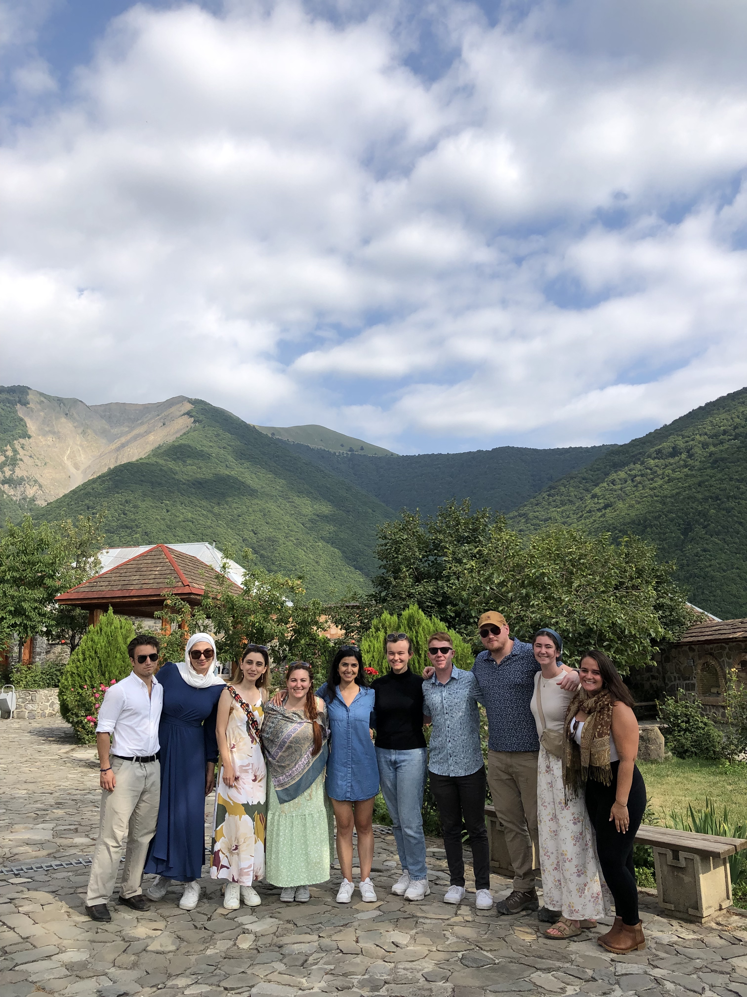
CLS [insert year] Program Experience
I spent a summer learning [language] in [program site]
Here are some highlights of my experience! With photos!
Use Your
Photos Here!
Notes:
Here’s where you can go into detail about your experience on the CLS Program. Include your own pictures to really make your story come to life and share your enthusiasm for the program!

Slide 4
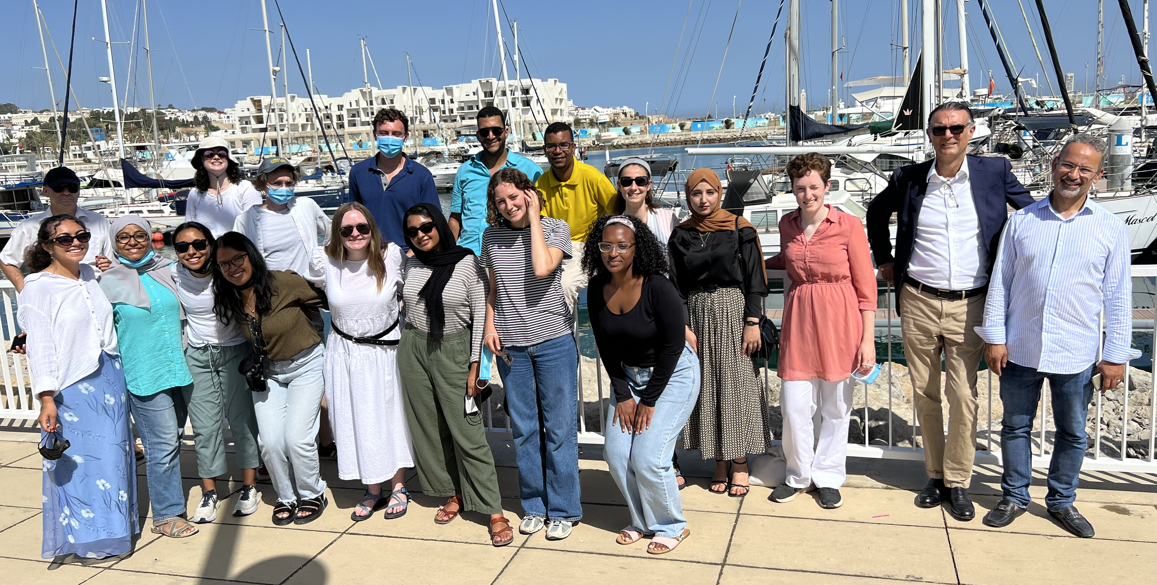
CLS [insert year] Program Experience
More information about my experience on the program! Topics could include
In-class experience
Virtual program experience
Experience living in your host city
Cultural activities and program excursions
Your language partner
Photos!
Notes:
Add as many slides as you’d like to show your experience on the program, but remember that you’re not giving a recap of every single activity you participated in. Try to stick to the highlights that show important parts of what made your CLS experience unique. Some topics could include:
Your language partner
Program excursions
In-class experiences
Everyday occurrences that taught you interesting things about the host culture
Virtual program experiences or experiences living in your host city

Slide 5
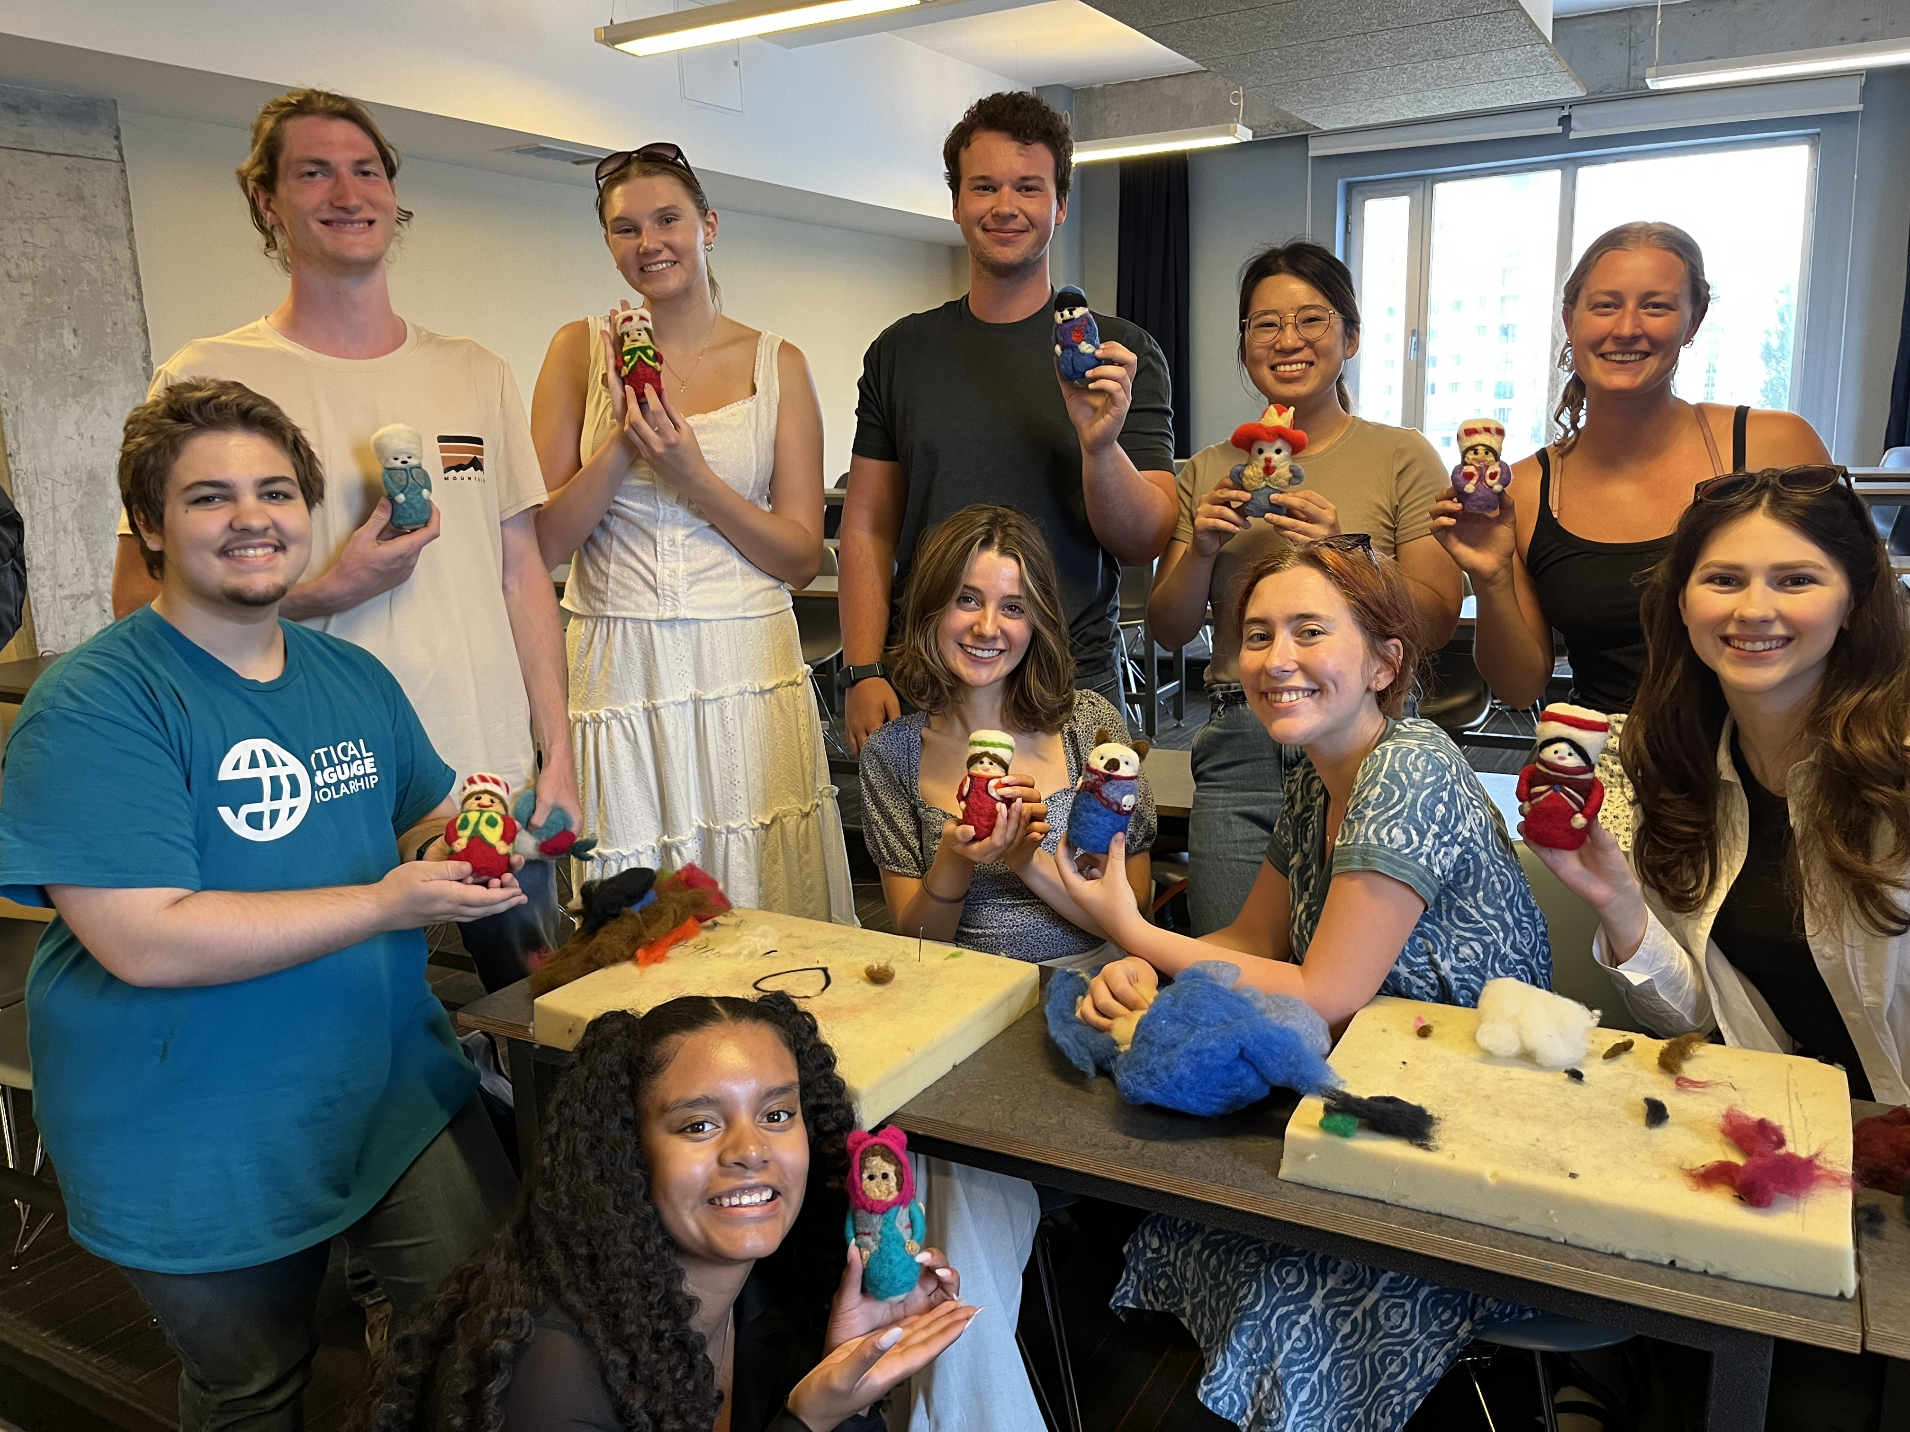
What is the CLS Program?
Immersive summer opportunity to study languages and cultures essential to America’s engagement with the world
Funded by the U.S. Government
Apply for a language program either overseas or offered virtually through CLS Spark

Slide 6
Languages Offered
The CLS Program Overseas Institutes
Experience Level | Languages
Open to students at all language levels, including beginners | Hindi, Indonesian, Persian, Portuguese, Swahili, Turkish and Urdu
One year of prior study required | Arabic, Chinese, Korean and Russian
Two years of prior study required | Japanese
Notes:
The CLS Program overseas offers instruction in thirteen critical languages. Some CLS languages have prerequisite requirements to participate in the CLS Program overseas. Arabic, Chinese, Korean, and Russian require one year of prior experience and Japanese requires two years of previous language learning experience to participate in the CLS Program at institutes abroad. Students applying for languages with required previous study may substitute other language learning experience for formal classes, such as self-study, tutoring, high-school coursework, or knowledge of the language from their home environment.
Further notes - Don’t worry about needing to know all of the prerequisites for the languages! This can give students an overview, and they can find more detailed information about language levels on our website.
The biggest distinction to know here is that CLS Spark, which is a virtual program, offers beginning-level instruction in the three languages listed.

Slide 7
CLS Program—Structure
Students participate as a cohort and share the same weekly schedule
Small classes
Individual consultations
Peer language partner
Cultural programming
CLS is not a research, independent study, or internship program
Notes:
The CLS Program takes place over the course of 8—10 weeks during the summer at overseas institutes. Students participate in the program as a member of a cohort, sharing the same schedule over the course of the program. There are 15 hours of language classes each week, cultural activities, and local excursions. Participants agree to a language policy that requires them to speak only in the language they are studying. Each participant is paired with a language partner who is a local student or member of the host community to practice speaking outside the classroom. Whenever possible the CLS Program will place students with host families or students may have a local university roommate.
Further Notes – You can share more information about your day-to-day experience on the program!
How much time did you spend in class? What was the workload like?
What kinds of cultural activities and excursions did you take part in?
What did you do with your language partner?

Slide 8
CLS Program—Benefits
Round-trip international airfare
Applicable visa fees
Housing and meals
Classroom instruction
Cultural programming and group trips

Slide 9
CLS Spark—Structure
Intensive virtual language and cultural learning program
10 hours of live class per week and 2 hours of cultural activities and individual consultations per month.
Offering language instruction at beginner level in Arabic, Chinese, and Russian
Group instruction provided by host institutions abroad
Professional development opportunities and inclusive on-program support
For undergraduate students only
Notes:
CLS Spark supports U.S. undergraduate students in all fields of study to learn either Arabic, Chinese, or Russian at the beginning level. It is offered for those who have no previous formal classroom study of these languages. If you have are at the advanced beginner, intermediate, or advanced level, you should apply for the CLS Program overseas institutes instead.
CLS Spark takes place over the course of 8 – 10 weeks during the summer. Small group classes and activities are facilitated by host institutions abroad. Each cohort of students participates in a total of 90 hours of programming throughout the summer. Each week, this includes 10 hours of live, synchronous class instruction. In addition, participants spend time learning about the culture of partner institutions in interactive and engaging cultural activities, such as tea ceremonies, calligraphy lessons, films, and virtual city tours. Each week, CLS Spark participants have individualized tutoring sessions with their instructors, adapted to their specific needs.
CLS Spark participants also have language partners from host communities to help practice everyday conversation skills. Participants of CLS Spark build community with each other through optional career development workshops and networking opportunities.

Slide 10
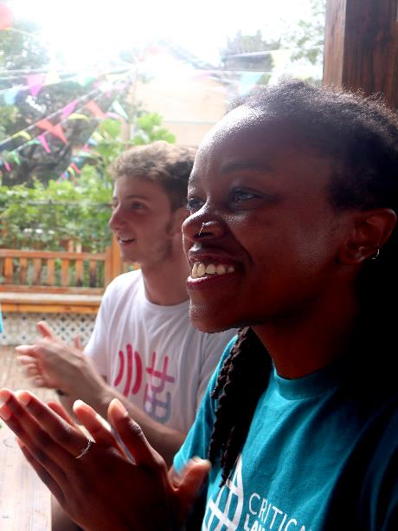
Accelerate Your Language Gains!
Make substantial gains in language skills:
Two semesters’ worth of coursework (and academic credit through Bryn Mawr College)
Certified OPI certificate to demonstrate language proficiency
Notes:
CLS Program participants make significant gains in their language abilities. In just eight to ten weeks, students complete the equivalent of two semesters of undergraduate coursework. Students receive certification of their language gains through an ACTFL-OPI certificate upon completion of their program. And while CLS participants have no service commitment to the U.S. government after completion of the program, alumni are eligible for non-competitive eligibility for U.S. government jobs, which makes pursuing a career in the civil service much easier if that is your goal. CLS alumni also become a part of the rich and diverse network of U.S. Department of State International Exchange Alumni.
Personalize this! What were your experiences of the benefits of the program?
Your language gains?
Any changes in your career or academic goals based on participation in the program?
Any skills outside of language gains that you developed as a result of participation in the program?
What has been your experience with the alumni community?
Any opportunities you’ve been able to take advantage of thanks to being an alumna/us of the CLS Program?
Any other alumni you’ve connected with throughout your time on the program or since?

Slide 11
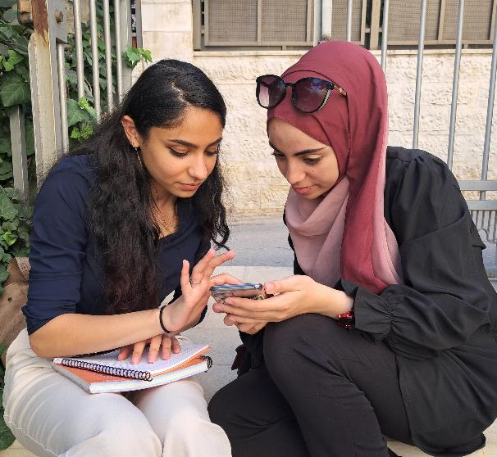
Advance Your Career!
Advance your career:
U.S. companies give advantage to candidates with language skills
Build experience in problem solving, adaptability, and other employable skills
CLS Program and Department of State International Exchange alumni networks and resources
Non-competitive eligibility (NCE) for federal government positions

Slide 12
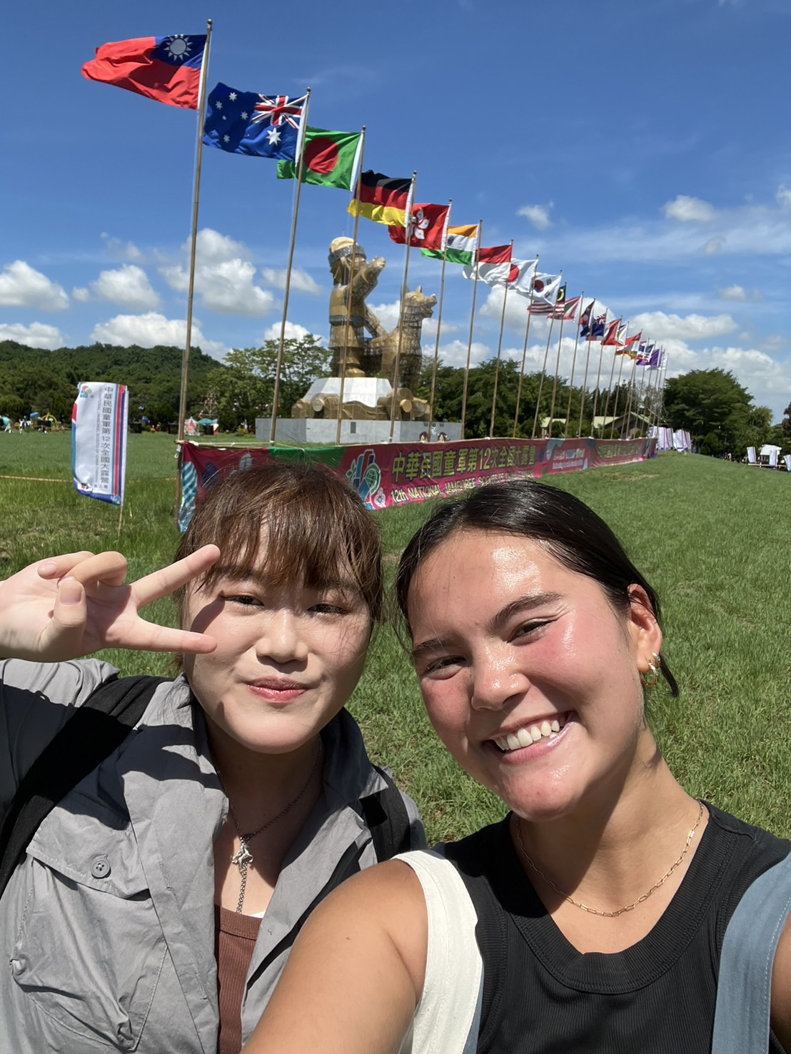
Eligibility
U.S. citizen or national
Enrolled in a degree-seeking program at a U.S. based institution
CLS Program: must be earning an undergraduate (associate, bachelor's) or graduate (master's, doctoral, professional) degree
CLS Spark: must be earning an undergraduate (associate, bachelor's) degree
Graduating seniors are eligible
No GPA requirement

Slide 13
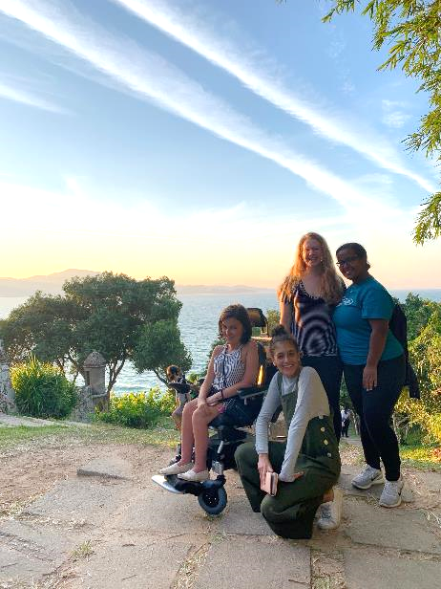
An Opportunity for Everyone
CLS represents the breadth of the U.S.:
All fields of study
All types of institutions and regions
Different levels of experience with language and travel
Over 50% self-identify as students of color
Over 30% receive Pell Grants
The CLS Program does not discriminate on the basis of disability or medical condition
Inclusive student support structures

Slide 14
CLS Program—Essays & Criteria
Three Short Answer Essays (300 words each)
Citizen Diplomacy and Mutual Understanding
Preparation for the CLS Program
Commitment to Language Study
Personal Statement (500 words)
No letter of recommendation required
Applicants should demonstrate a strong connection between participating in the CLS Program and their career and academic goals
Applicants must also show resiliency and preparation for an intensive and immersive language program

Slide 15
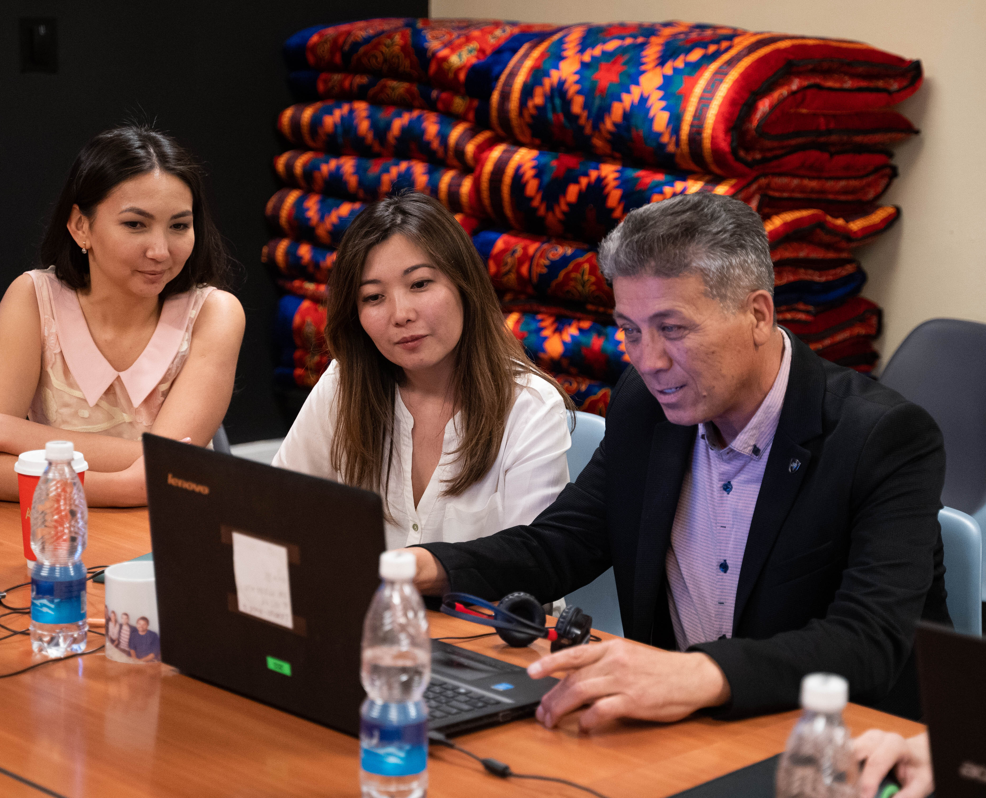
CLS Spark—Essays & Criteria
Three Short Answer Essays (300-350 words)
Motivation and Commitment
Access to Language Learning Opportunities
Statement of Experience
No letter of recommendation required
Applicants should focus on the impact of CLS Spark on their access to language and intercultural learning opportunities
Preference is given to applicants from campuses that do not offer the target language

Slide 16
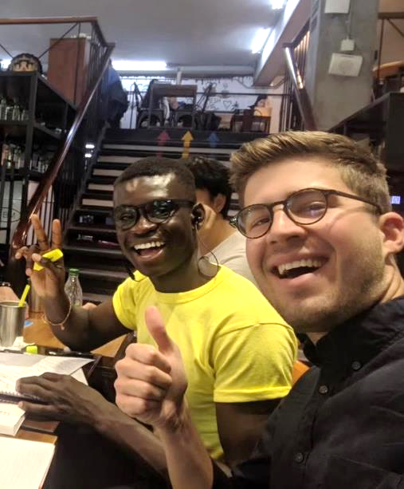
Resources!
Do your homework
Do research to connect the career path you are on to one of these languages/cultures
Watch the application tips video!
Seek help on your campus!
Instructors and advisors
Writing centers
Study abroad, fellowships, and scholarships offices

Slide 17
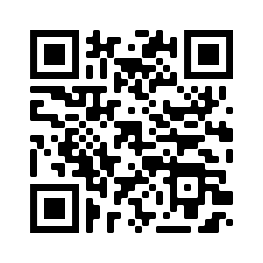
Apply for Summer 2025
Application Deadline: November 19, 8:00pm EST
Semifinalist Notification: Late January
Finalist Notification: March
Programs Begin: June
Online application at
www.clscholarship.org/apply

Slide 18
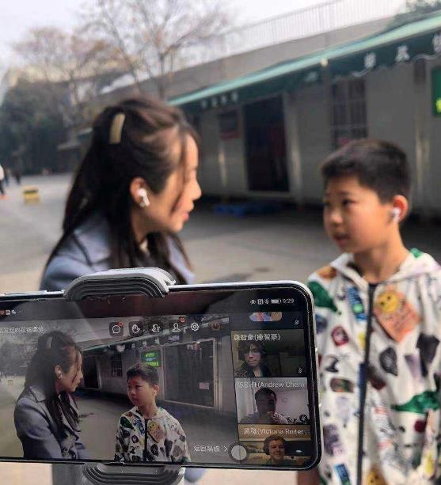
Stay in Touch
Follow us for updates!
Join us for future webinars.
Register at clscholarship.org/events
@CLScholarship
@CLSScholarship
fb.com/CLScholarship

Slide 19
Questions?
cls@americancouncils.org
CLScholarship.org
@CLScholarship
fb.com/CLScholarship
@CLSScholarship

